Slide 1
Quality guidelines for Medtronic distributors

Slide 2
Quality guidelines for distributors
contents
Product Complaints
Field Corrective Actions (FCAs)
Product Handling
Change Control
APPENDIX: How to use mPXR to report a product complaint

Slide 3
Product complaints

Slide 4
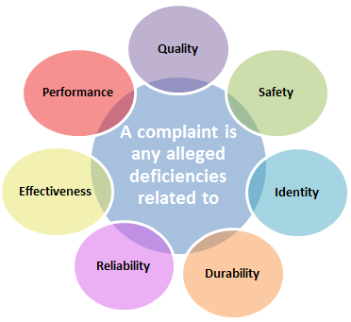
Product complaint handling
General concepts
What is a Product Complaint?
Complaints are not considered:
Design Tips
Complaints relating to cost or revenues
Complaints about service or shipping
Requests for replacement product without express dissatisfaction or device failure
Examples:
Identity - The serial number does not match the label.
- Product size does not match the label.
Quality- Broken safety seal.
Durability - Premature battery depletion
- Corrosion of equipment after decontamination
Reliability - an alarm of a device turns on occasionally
Safety – Blockage of Insulin Pump
Effectiveness - The symptoms do not improve in spite of having the device.

Slide 5
Product complaint handling
General concepts
Sources:
Product complaints can present themselves through any of the following sources:
Customers (Patients, Physicians, Medical Professionals, Medical Institutions, Insurance Companies)
Regulatory Authorities
Medical or scientific literature (published or unpublished)
Own research, testing, evaluation, servicing or maintenance of Medtronic devices
Adverse events collected in clinical studies

Slide 6
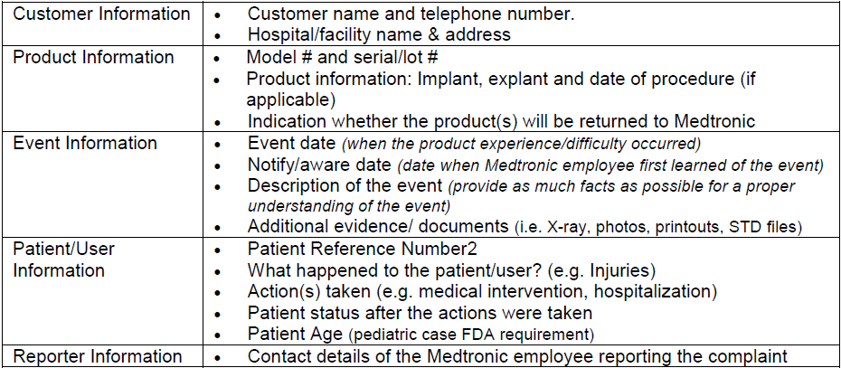
Product complaint handling
General concepts
In order to report a complaint you must initially have the following information:
Importance of Reporting
Reporting within 48 hours ensures:
Information reaches the right people and is not lost.
The regulatory requirements are met.
The issue will be investigated on a timely manner
If necessary, Field Corrective Actions are initiated, changes in design and manufacturing, as applicable, are
implemented.

Slide 7
Field corrective actions (fcas)

Slide 8
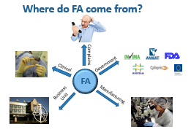
Field corrective action process
Basic concepts
A Field Corrective Action or (FCA) is a corrective action that a manufacturer (Medtronic) takes in order to prevent the risk associated with the use of a medical device that is either commercialize or distributed.
The risk can vary from health deterioration to death of a patient.
FCAs may include the following types of activities:
Product Retrieval
Communication to customers of actions needed related to product performance issues
Educational briefs
Advisory notices
Health safety alerts

Slide 9
Field corrective action (FCA) process
Examples of fca
This type of FCA require to retrain the patient or Health care provider on how to use a device again due to a software update or new way to property use the device.
Example: Teaching a diabetic patient how to property load insulin pump.
Retraining/
Software update
Rework
This type of FCA usually involves a change or modification to a label of a device. This change has to be approved by the business unit and they will provide the new label/packaging with instructions on what is required of the distributor to do.
Customer Communication
Repair
This type of FCA involves a reparation of a device and instructions will be provided on how to proceed with the repair.
This type of FCA involves a product retrieval it can be voluntary by the company or due to
problem identified by users, government, etc.
The Product can then be:
Return to the manufacturer or
Scrapped
Recall
This type of FCA is the most serious and it requires for a implanted device to be explanted from a patient because is life threatening to the health of the patient.
Ex: Explant of hip prosthesis due to failure detected due to metal to metal interaction.
Explants

Slide 10
Field corrective action process
Fca phases
Field Actions are divided in three phases and the distributor will be in charge of two phases: Execution of FCA and Closing of FCA.
FCA communication
Execution of FCA
Closing of FCA
Medtronic representative will contact all affected distributors via e-mail, phone call, registered mail.
This notification will come as a package with different section that will detail all the actions the distributor must take.
The package will contain but not limited:
Customer Letter
Customer Contact Record (CCR)
Field Action Confirmation Sheet (FACS)
Return Instructions
Other (ex. disposal instructions if applicable)
The package must be returned to sender by the given deadlines

Slide 11
Field corrective action process
Distributor actions
FCA communication
Execution of FCA
Medtronic representative of your region will contact the distributors about the new Field Actions.
Action: PACKAGE SENT TO DISTRIBUTOR
DISTRIBUTOR’S TO DO LIST:
Read each part of the package. The sections of the Field Actions and the require actions by distributors are described in this training material.
A timeline will be provided with due dates for each section. Note: These timelines are very important and should be strictly followed by all distributors.
Communication with Competent Authorities: Depending on your country’s regulations, you must inform the Regulatory Agencies of any new Field Action affecting your region regardless if the FA is regulated or not following the timeline provided.
4. Start communication with Patients/Doctors/Hospitals only use the letters provided in the package and make sure to document all communication using the Customer Contact Record (CCR forms). Execute and document at least (3) attempts for customers not responding.
Note: If you hold the Distribution License is may be your responsibility (based on country / region regulation) to inform the authorities, of the opening and closing of the FA. Please communicate with your Quality Specialist/Regulatory Agency if you have any inquiries.

Slide 12
Field corrective action process
Distributor actions
Execution of FCA
Closing of FCA
FCA communication
DISTRIBUTOR’S TO DO LIST:
Following the timelines after all customer communication has been completed. Make sure to fill out the Customer Contact Records (CCR forms), as well as provide feedback if some costumers were not found.
Provide prove of return items
Note: Tracking numbers are very important
3. If a distributor holds the Distribution License for the product affected in the FCA, it is their responsibility to also inform the Regulatory Agency of your country of the closure of FCA.
4. Please sent copy of all these documents to your Medtronic Representative.
Once you have provided all information the Medtronic Representative will fill out the Field Action Confirmation Sheet (FACS sheet )and officially close the Field Corrective Action.
A timeline will be provided to you with due dates for each part.

Slide 13
Product handling

Slide 14
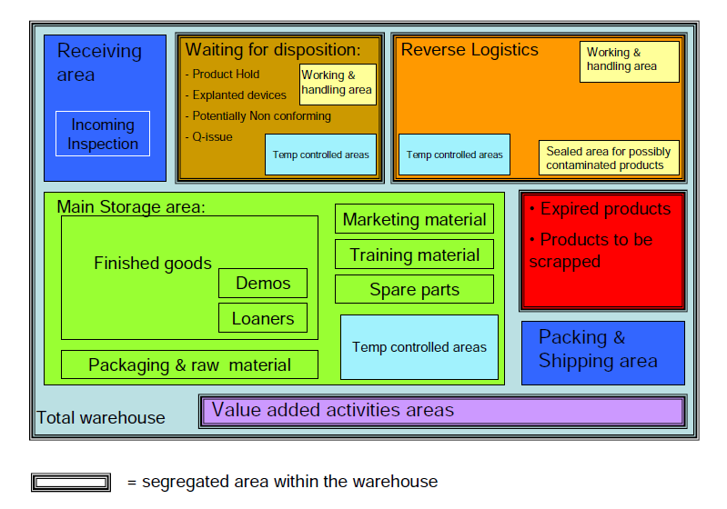
Product handling
segregation
This diagram below should provide an idea on the ideal warehouse segregation that Medtronic expects from distributors .
Areas must be clearly identified in order to minimize the risk of errors, cross contamination , mixtures and generally any effect which affect the quality of the products.
Storage areas should be designed or adapted to ensure good storage conditions (clean within acceptable temperature limits) .

Slide 15
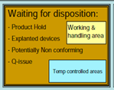
Product handling
segregation
Controlled Access - only authorized personnel can have access to the products and areas (It is not allowed to store product in open areas, or desks).
Receiving Area- Each shipment must be checked against the list of contents , quantity and external damage boxes.
Items will be identified and segregated as a group according to their status : Quarantine, Returns , Disposal , Demos, Nonconforming , Recalls, Products on Hold (PHO), etc.
Expired products must be electronically and physically segregated.
Scraps- In the event that products need to be destroyed , this should be done by a qualified technician who is registered with local authorities. The distributor shall deliver a certificate of destruction.

Slide 16
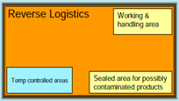
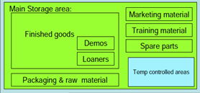
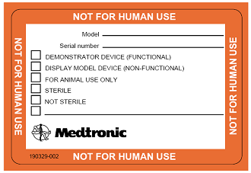
Product handling
segregation
In this area returned product from customer, trunk stuck, complaint products, potential non-conforming, pending tech-service can be found.
Timely inspection of products received (including reverse logistics ) for delivery by verification of (quantity, serial / lot number, UPN) and damage.
PHOs, and non-conforming products must be segregated and maintain locked in order to prevent its distribution.
Note: Traceability of the individual in charge is very important.
Non-Conforming: is one that has any type of cosmetic or functional deviation outside the original specifications given by the product manufacturer .
Depends on local organization to determine whether a cosmetic deviation is not acceptable considering the country's requirements .
Demos- The demonstration devices must physically be clearly identified as "not for human use " to prevent unauthorized use and / or not intended at all times.
Seals and sterile barrier must be removed or broken.
Samples- are offered to clients free of charge.

Slide 17
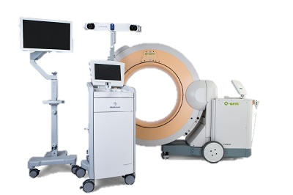
Product handling
segregation
Products must be packed in boxes or containers that protect against deterioration and external influences and should be marked appropriately.
Must be transported so that their integrity and storage conditions is maintained.
Distributors must maintain records to ensure traceability and should be available so that they can be inspected.

Slide 18
Product handling
Cleaning and pest control
CLEANING
Storage areas should be cleaned and accumulated waste removed at regular intervals. The frequency and methods of cleaning the premises and areas should be recorded.
Smoking, eating and drinking should be permitted only in segregated areas, and not in those areas used for storage and handling of the product.
PEST CONTROL
Products shall be stored free from pest, and pest control measures shall not have any adverse effect on products.

Slide 19
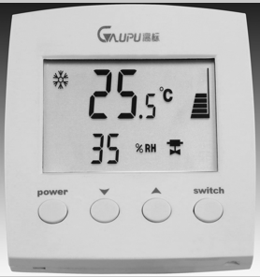
Product handling
Temperature / humidity control AND Special conditions
Product shall be handled (during storage and transportation) as per temperature / humidity and/or other special handling conditions according to the products labels.
Registration and monitoring of temperature and humidity is required as per contract.
The sensors are calibrated regularly and calibration status is indicated on the sensors.
Excursions shall be investigated, product segregated and dispositioned

Slide 20
Change control

Slide 21
CHANGE CONTROL PROCESS
REASONS FOR CHANGE CONTROL
Protect our internal and external customers
Meet Regulatory requirements
Meet Medtronic Policies and Procedures
POTENTIAL CONSEQUENCES
Patient Impact to Health and Safety
PHO’s, FCA’s , External Regulatory Findings,
483’s (FDA)
Internal Audit Findings, CAPA’s, Business Disruptions
Process Flow Chart

Slide 22
CHANGE CONTROL PROCESS
The distributor is responsible to communicate to Medtronic (in writing) proposed process changes prior to implementation. Changes shall not be implemented until written approval is received by Medtronic.
The following are examples of common process changes (others may apply as per contract and local regulatory requirements):
Change in facility location
Changes in name (Company name)
Additions to facility/facilities modifications or major layout changes
Changes on environmental conditions ( ex. temperature/humidity parameters)
Changes in advertisement or promotional materials
Labeling changes (additions)
Additions or changes of sub distributors

Slide 23
Change control Plan Creation/Approval
At a minimum, the distributor shall provide the following information (in writing) to Medtronic for evaluation and approval:
Description of current situation
Description of planned change
Description of future situation
Timing of change
Reason for change
Affected procedures/work instructions
Impact of change/risk/mitigation plan (if applicable)
Contact person
Revision history: to record changes to the original version due to changes in plan, time, action, etc.
Medtronic may require additional information related to the change
The distributor shall have controls in place to avoid implementation prior to Medtronic approval (written approval)
Upon approval or rejection, Medtronic will communicate to the change requestor its determination in writing

Slide 24
appendix How to use mPXR to report a product complaint

Slide 25
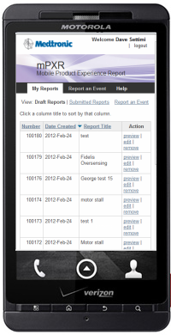
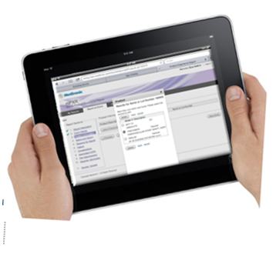
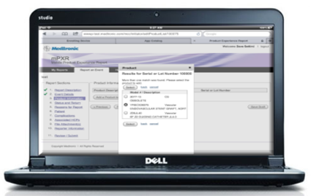
What is mpxr?
mPXR is a web-based application to submit a product event report using:
No need to be on the Medtronic network to submit a report!
iPhone
Laptop
Android Phone
iPad

Slide 26
WHAT IS mPXR?
WHY MPXR?
Reduce effort in the field by replacing manual PIR/PER forms
Eliminate or reduce follow-up on submitted reports
Improve accuracy, completeness and delayed reporting of product events to regulatory bodies
One Medtronic solution that can be globally deployed across multiple businesses
TOP FIVE FEATURES TO REDUCE EFFORT AND FOLLOW-UP CALLS
The report can be started on one device (iPad, laptop or phone) and finished on another device.
Multiple attachments can be sent with the report.
mPXR will identify any missing information prior to submitting report.
Product experience reports are sent directly to complaint handling groups

Slide 27
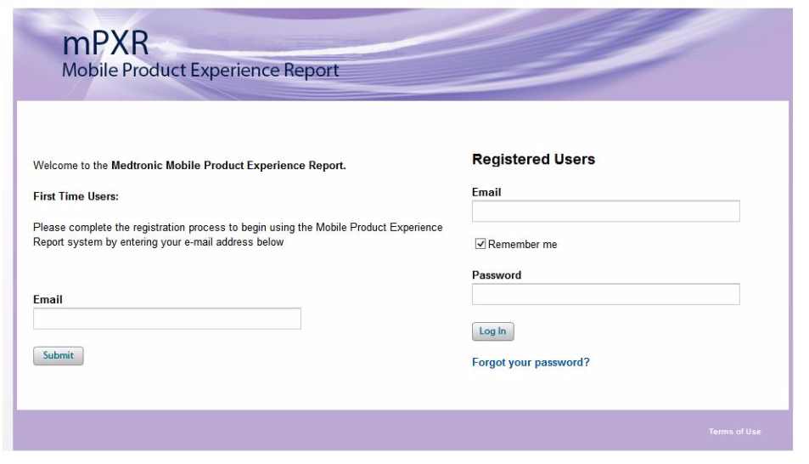
FROM A COMPUTER

Slide 28
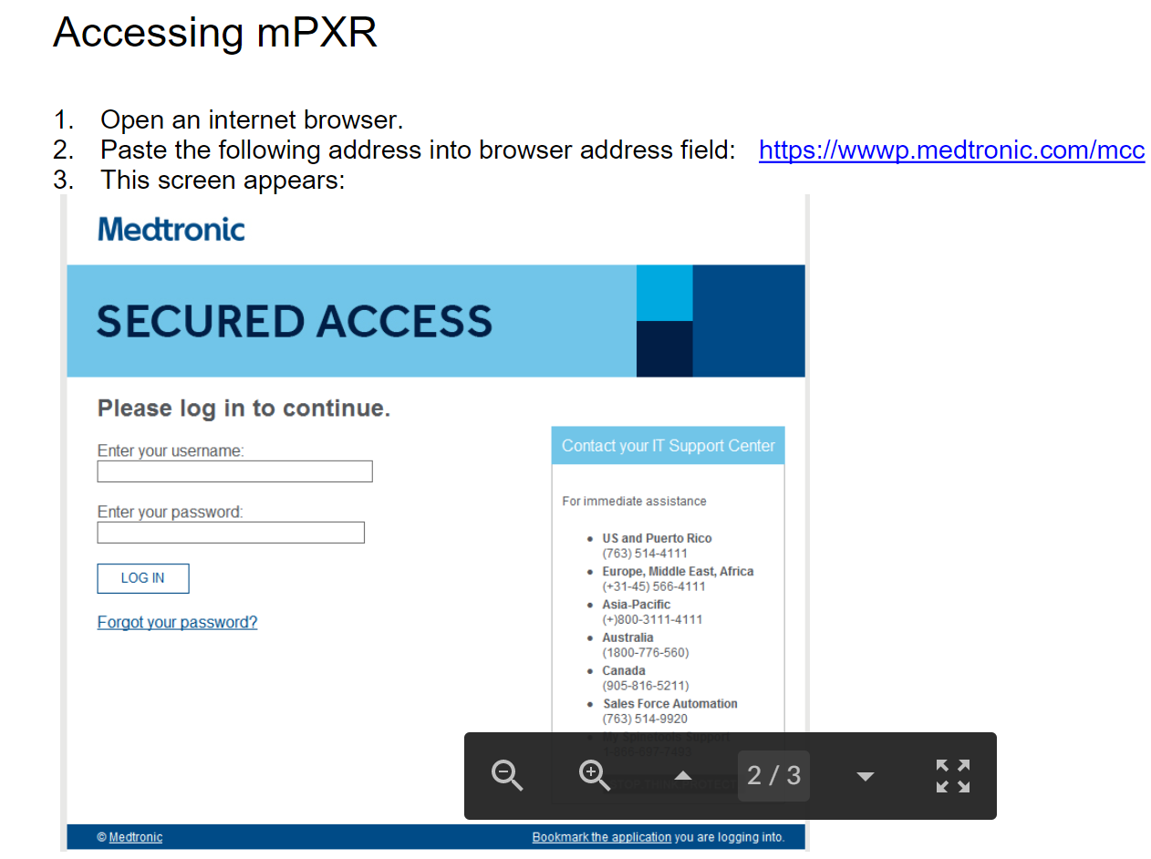
From a Computer
Website: https://wwwp.medtronic.com/extregistration/login/showLogin?appName=MPXR

Slide 29
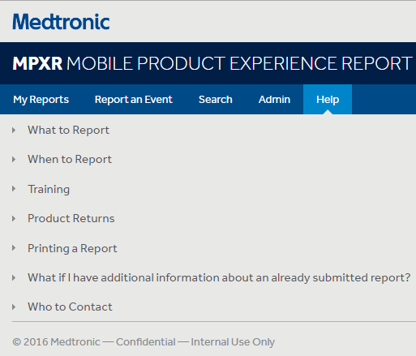
Additional Training Available
An overview video on “how-to” navigate and the basic functionality of the mPXR app is also included in the email communication
Help tab in the mPXR app

Slide 30
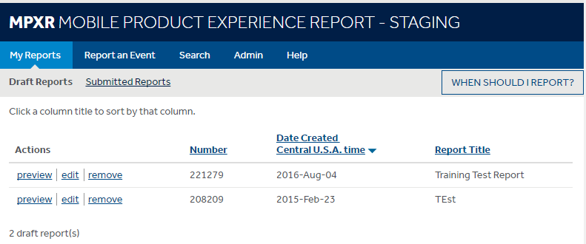
Mpxr home page
Click Help to learn:
When to submit a report
Product returns
Returned product analysis
Rush requests
Who to contact
Click Draft Reports or Submitted Reports link to view your draft or submitted reports.
Click Report an Event link to submit a report .
Click preview, edit or remove link to preview, edit or remove a report that has been started.

Slide 31
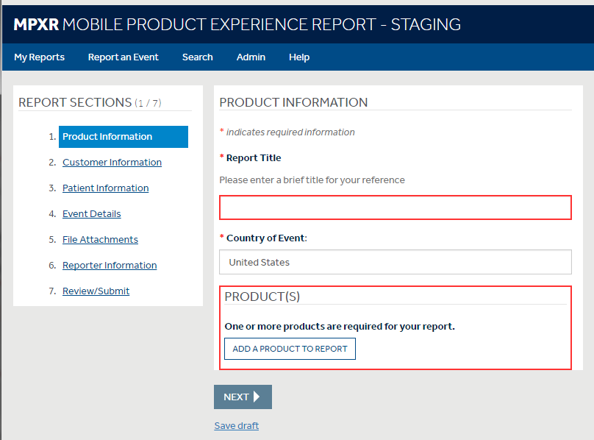
Mpxr functionality
You are able to move around using the Report Sections.
Click on the section you would like to go to.
Note: A Report Title is required on the first page before moving to a different section
Once a report is initiated, it can be saved as a draft by clicking Save Draft button.
Note: If you do not complete the report in 72 hours, mPXR will automatically submit in order to meet reporting timelines. This will most likely result in a follow-up call to you.

Slide 32
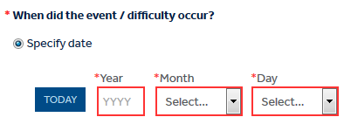
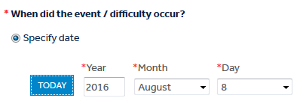
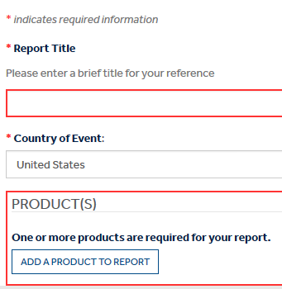
Mpxr functionality
Date fields are spread throughout the application.
Type in the year and select the other date components from the dropdowns.
Required Fields are marked by an asterisk and a shaded box.

Slide 33
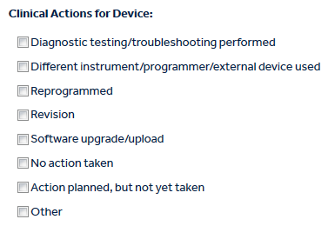
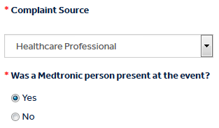
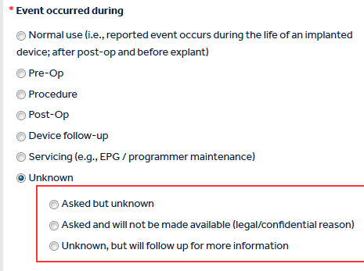
Mpxr functionality
Throughout the app,
Check Boxes,
Radio Buttons,
and Drop Downs
are used for data entry.
For check boxes click all that apply.
Note: Use ‘Unknown’ options if you don’t know or aren’t able to get information.

Slide 34
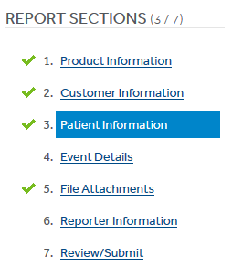
Mpxr functionality
Completed Sections:
Completed sections are marked by a green check mark in the navigation pane on
the left side of the application.

Slide 35
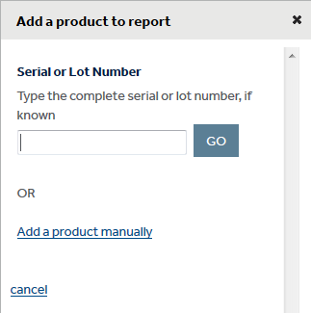
Mpxr functionality
Pre-populate Patient and HCP Information
Information can be pre-populated with a registered Serial Number.
Enter Serial Number, select Go button.
Select the product(s) associated with the event.
If the registered serial number is not available, the Product Information can be entered manually.

Slide 36
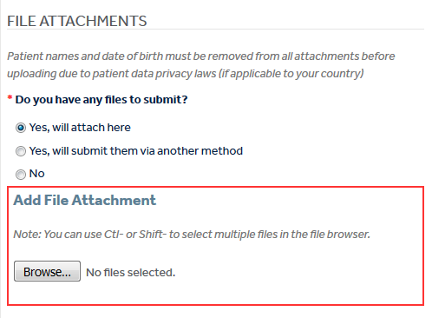
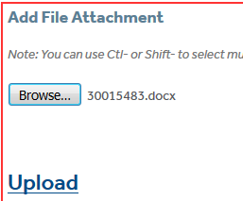
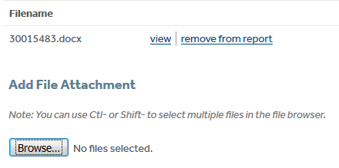
Mpxr functionality
Document-type attachments can only be added via your laptop. Photos can be added via all devices.
Click Browse button to select the file to be attached (multiple files can be attached at once).
Click Upload button.
View or Remove the attachment or Browse to add more attachments.

Slide 37
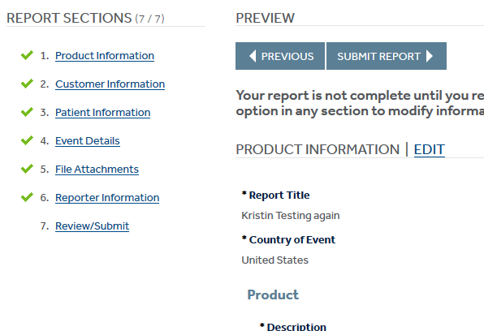
Mpxr functionality
Click Review / Submit to review the report and submit it.
Print a copy of the report from your laptop or write down the mPXR number if using a tablet/phone on the packing slip Include the packing slip with the product in the return mailer kit.

Slide 38
Thank you!

